Slide 1


HOLIDAY PACKAGE
ACCEPTANCE PREDICTION
Simplify Your Hospital Administration
AVENGERS ON HOLIDAY | FINAL PROJECT RAKAMIN ACADEMY BATCH 32

Slide 2
AVENGERS ON HOLIDAY KELOMPOK 6
Today's Agenda
Who are the people behind the project?
What is the problem?
How is the current condition?
How to overcome the problem?

Slide 3
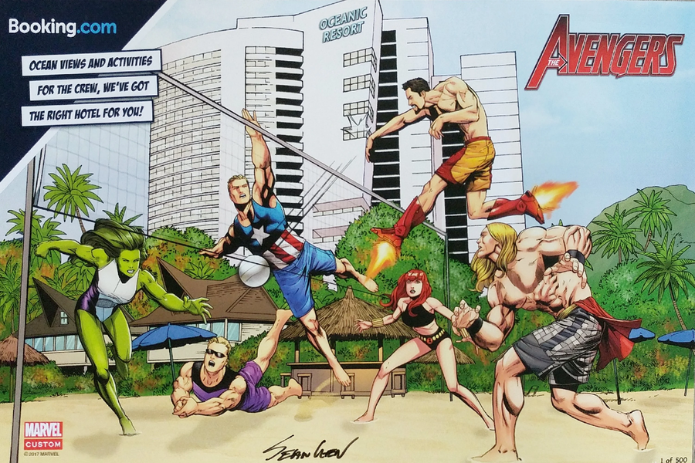
Who are
Avengers on Holiday?
AVENGERS ON HOLIDAY KELOMPOK 6
The Idea
an all-star ensemble cast of established superhero characters to tackle especially formidable villains.
Our main goal is to become an all star roster that tackles formidable problems, especially in the data science domain.
The Team
Aulia Pramesthi
Chairunnissa
Kinanti Salsabila
Galih Jaya
Jonathan Geraldin
Tanda Jatiningsih

Slide 4
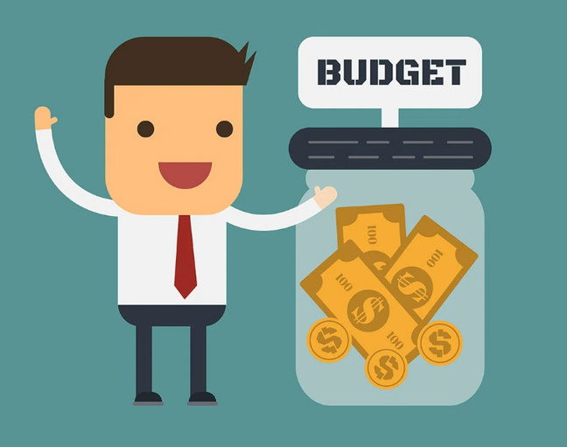
What is the Problem?
AVENGERS ON HOLIDAY KELOMPOK 6
Product
Conversion Rate
Marketing
Cost
Taken
18%
Not Taken
82%
Last year, Trips & Travel.com had a product conversion rate of rate of only 18%. Not only that, the marketing cost was quite high because customers were contacted at a random rate

Slide 5
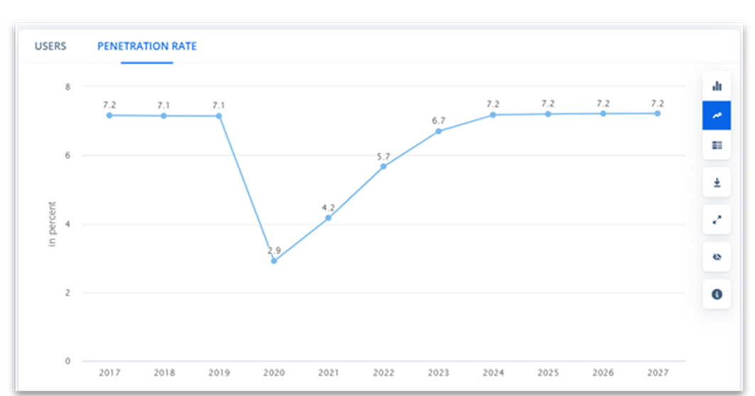
What is the Problem?
AVENGERS ON HOLIDAY KELOMPOK 6
Worldwide User
Penetration Rate Statistics
Worldwide user penetration rate for holiday packages showing an increase for the next 5 years, meaning more people are accepting holiday packages.

Slide 6

What is the Problem?
AVENGERS ON HOLIDAY KELOMPOK 6
Background
Low product acceptance/conversion rate and high marketing costs due to contacting customers at random, while penetration rate for holiday packages continue to grow.
Goals
Increase product conversion rate and lowers marketing costs
Objectives
Create a model to predict potential product acceptance with a higher accuracy and higher conversion rate.
Business Metrics
User Conversion Rate (CVR) and Marketing Costs

Slide 7





How is the Current Condition?
EDA & INSIGHT
DATA OVERVIEW
CUSTOMER
INFORMATION
INFORMATION OF
PITCH
PRODUCT TAKEN

Slide 8


Customer Information
Customer ID
Age
City Tier
Gender
NumberOfPersonVisiting
PreferredPropertyStar
MaritalStatus
NumberOfTrips
Pasppport
OwnCar
This is the onboarding page of our app that contains an introduction and information about Healthio.
NumberOfChildrenVisiting
Designation
MonthlyIncome

Slide 9

a
Information Of Pitch
TypeOFContact
NumberOfFollowups
DurationOfPitch
ProductPitched
PitchSatisfactionScore
This is the onboarding page of our app that contains an introduction and information about Healthio.

Slide 10



Target
ProdTaken
Yes
No

Slide 11
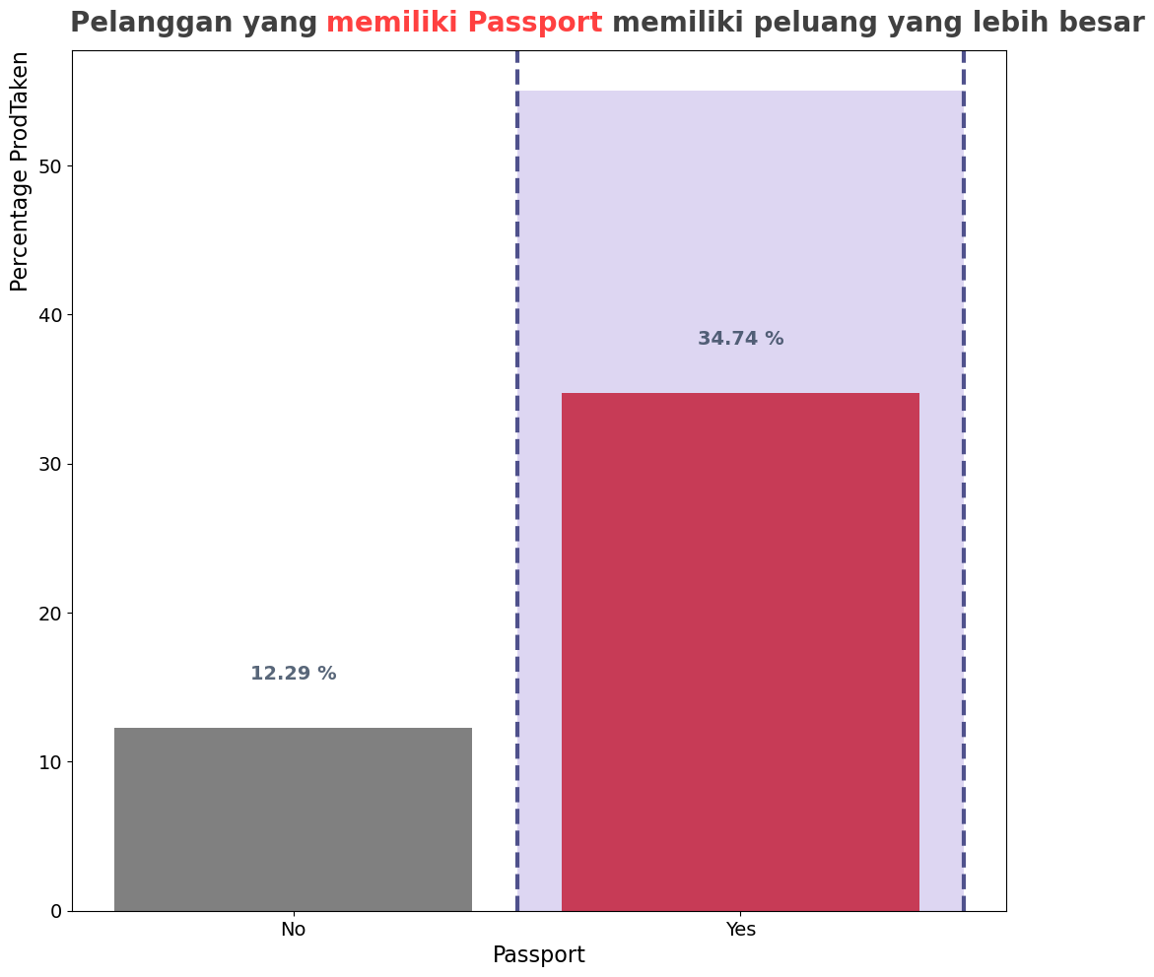
Customer who have Passport,
have bigger convesion rate.
Notes:
tambahin apa aja yang harus diisi pas register dan di profilenya
authentication

Slide 12
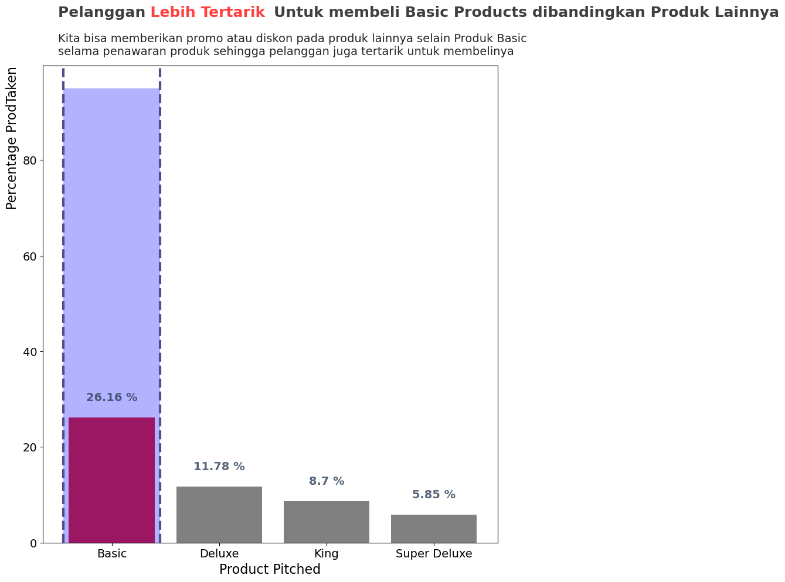
Customer are more interested in BASIC Holiday Package.
Notes:
tambahin sort criteria nya

Slide 13
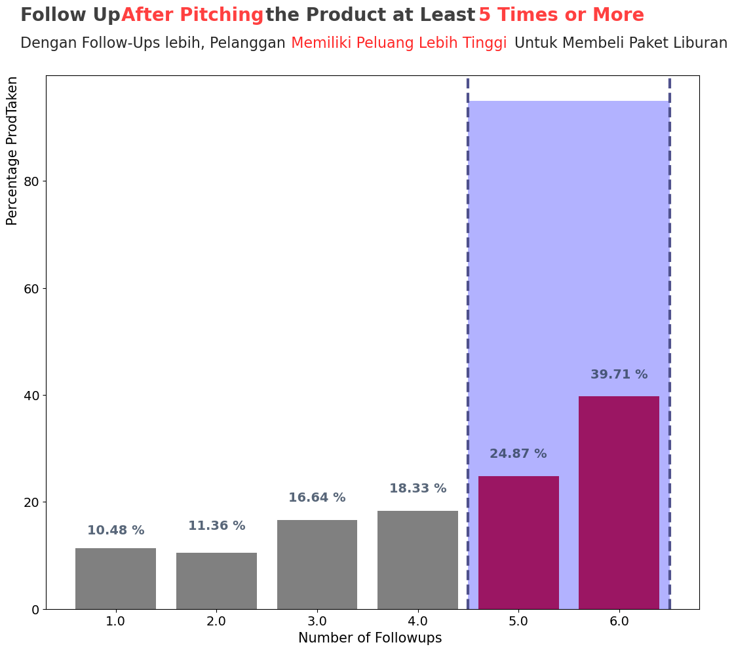
With more FollowUps after pitching the product at least 5 Time or more. Have a higher Change customer to buy Holiday Package.

Slide 14
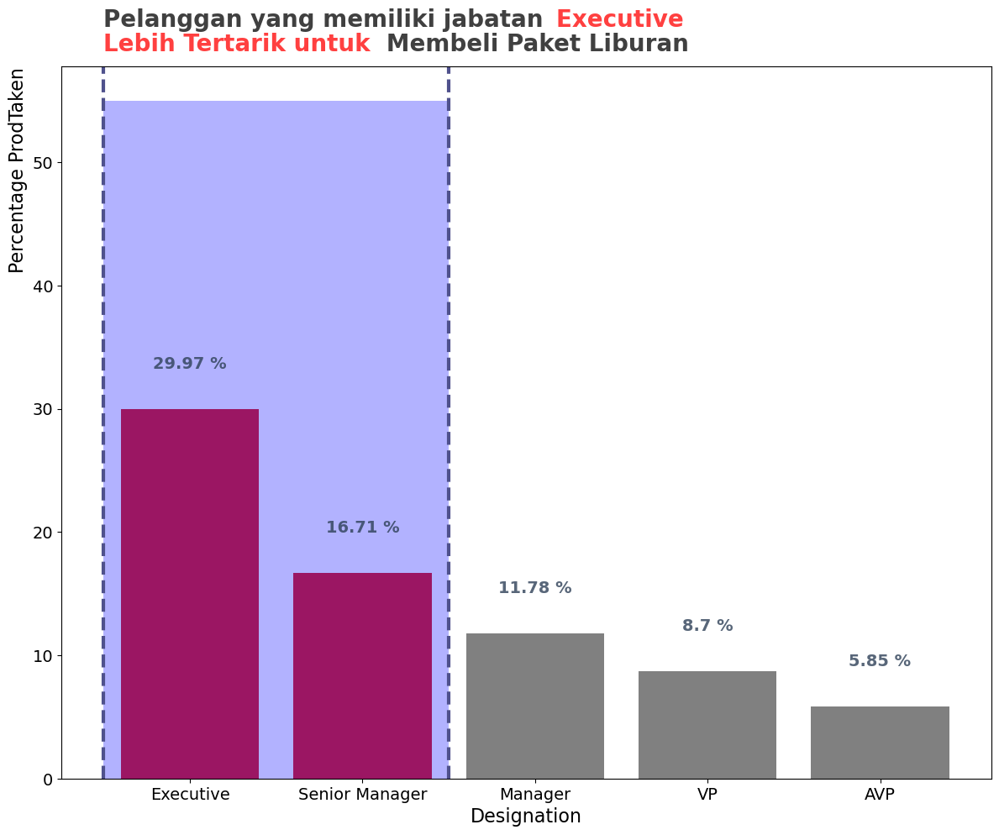
Customers with Executive and Senior Manager titles, purchased more holiday packages.

Slide 15
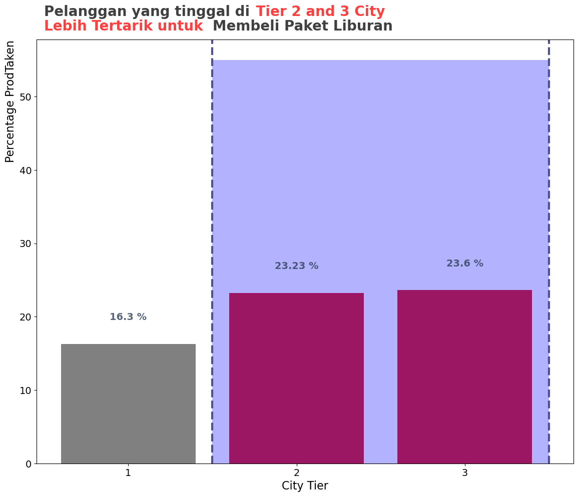
Customer who live at City Tier
2 and 3. More interested
to buy Holiday Package

Slide 16
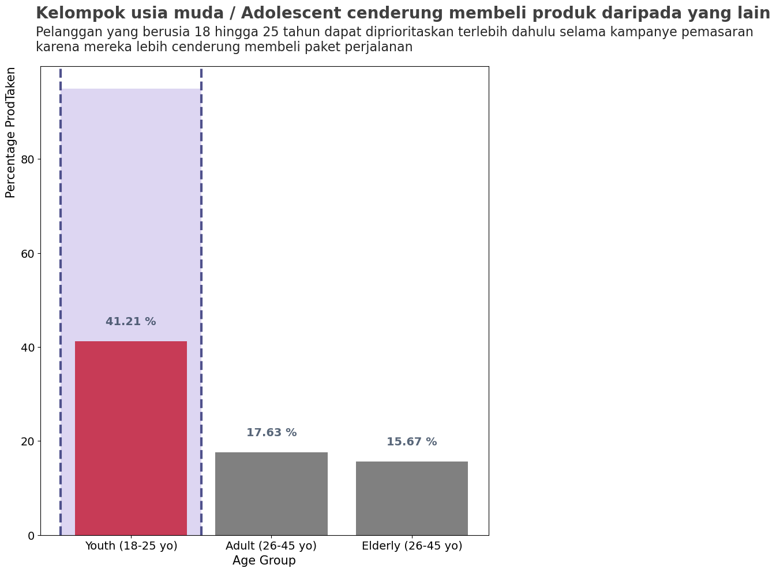
Age between 18 - 25yo more likely to buy the package holiday than other.

Slide 17
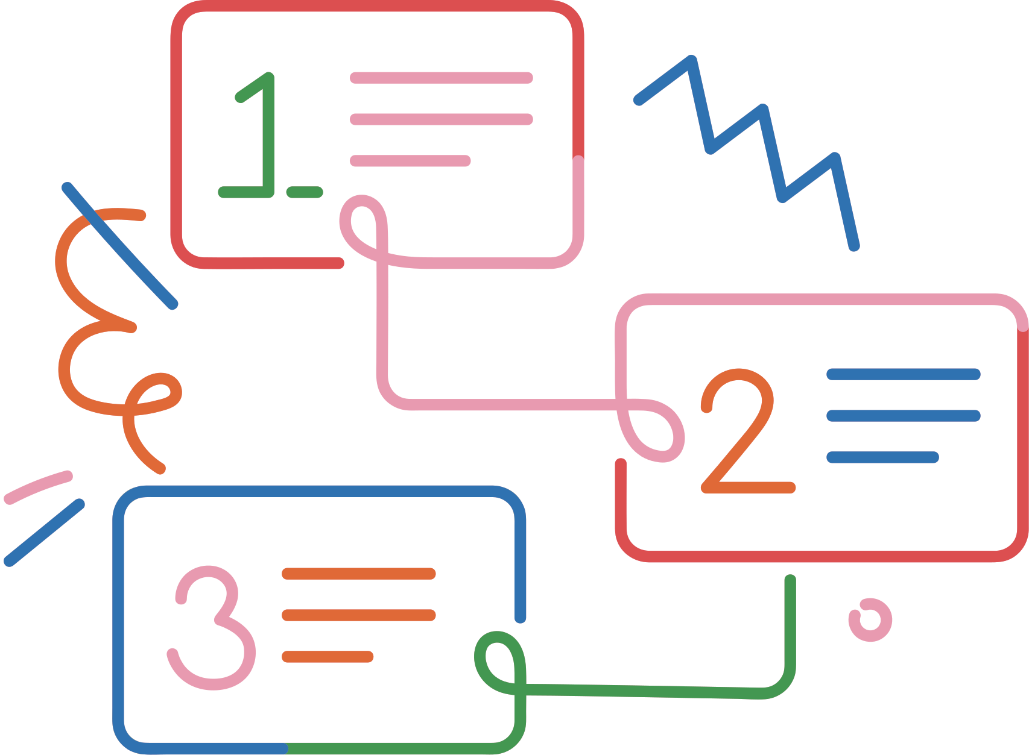

How to Overcome the Problem?
Data Cleansing &
Preprocessing

Slide 18
Data Cleansing & Preprocessing
Missing, Value Replacement, & Removing Features
Outlier Handling
Feature Encoding
The cause of missing values can be data corruption or failure to record data . Values of the DataFrame are replaced with other values dynamically.
We handle outliers with IQR and standardization/ normalization to make sure all features are stable for modelling
We handle it with One hot encoding is a technique that we use to represent categorical variables as numerical values in a machine learning model.

Slide 19

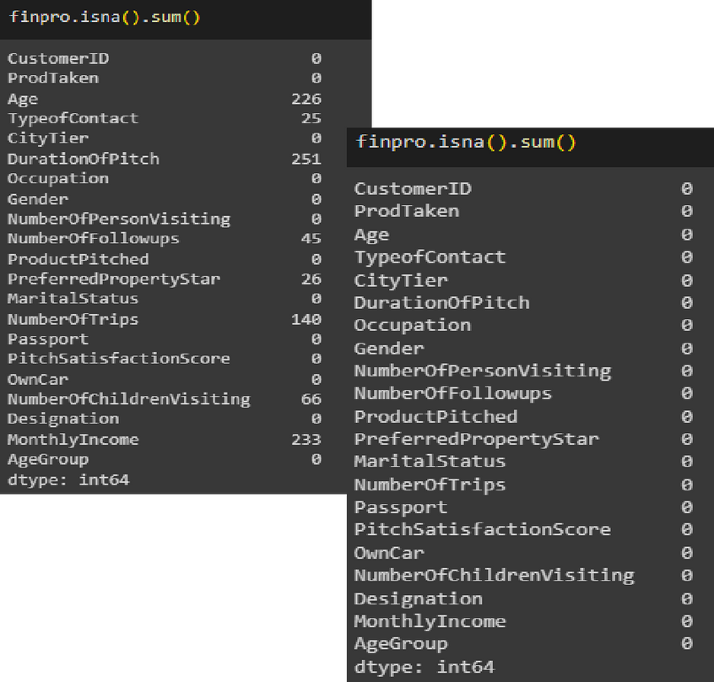
HANDLING
MISSING VALUE
HANDLING MISSING VALUES STARTS WITH IDENTIFYING WHICH COLUMNS HAVE MISSING VALUES, FOLLOWED BY ANALYSING THE DISTRIBUTION OF THE DATA (STAGE 1)

Slide 20
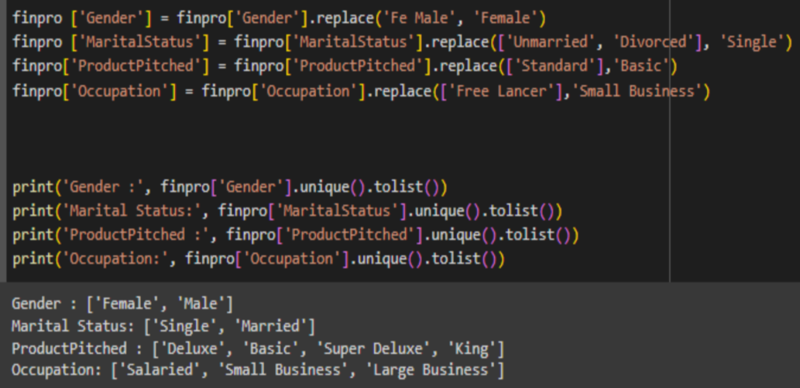

HANDLING
INCONSISTENT DATA
HANDLING INCONSISTENT DATA IN GENDER, MARITALSTATUS, PRODUCTPITCHED AND OCCUPATION COLUMNS.

Slide 21

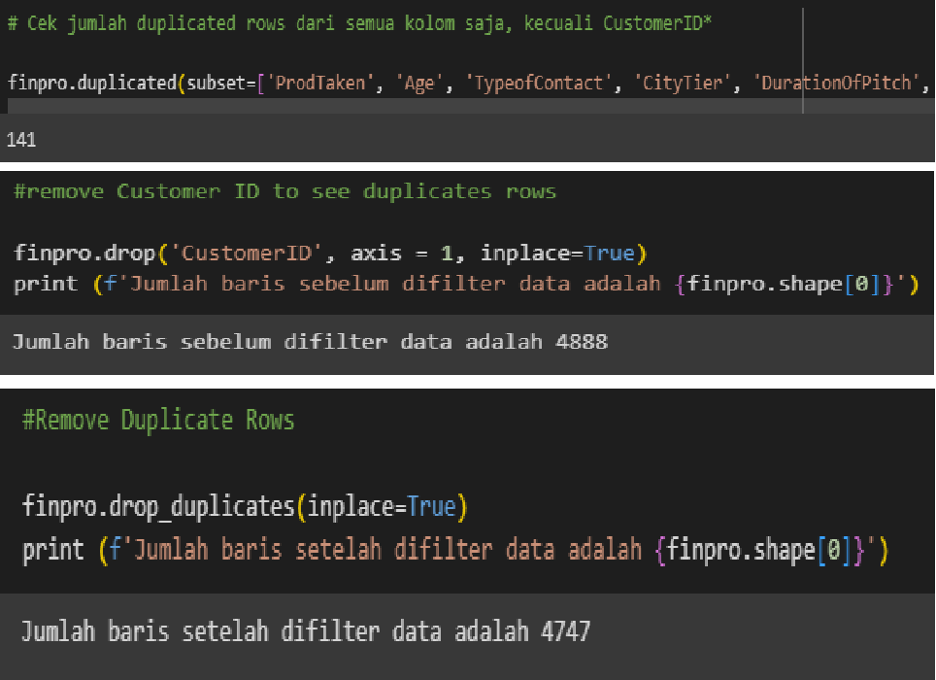
HANDLING
DUPLICATE VALUES
MAKING SURE THAT THERE ARE NO DUPLICATED DATA IS ONE OF THE ASPECT OF UNDERSTANDING THE DATA ITSELF.

Slide 22

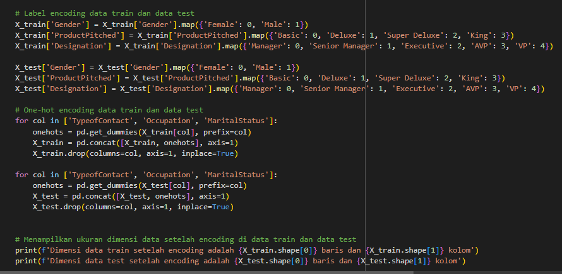
ENCODING
TO MAKE DATA SAFELY AND ADEQUATELY CONSUMABLE BY DIFFERENT USERS USING VARIOUS SYSTEMS. FOR PRODTAKEN, TYPEOFCONTACT, OCCUPATION, GENDER, PRODUCTPITCHED, MARITAL_STATUS, DESIGNATION AND PASSPORT COLUMNS.

Slide 23
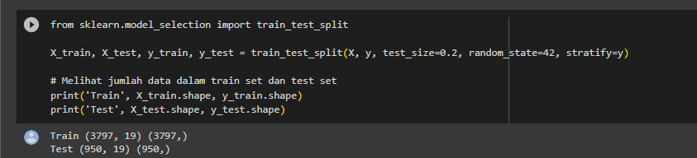

SPLIT DATA
TRAIN & TEST
IN A BASIC TWO-PART DATA SPLIT, THE TRAINING DATA SET IS USED TO TRAIN AND DEVELOP MODELS. TRAINING SETS ARE COMMONLY USED TO ESTIMATE DIFFERENT PARAMETERS OR TO COMPARE DIFFERENT MODEL PERFORMANCE.

Slide 24

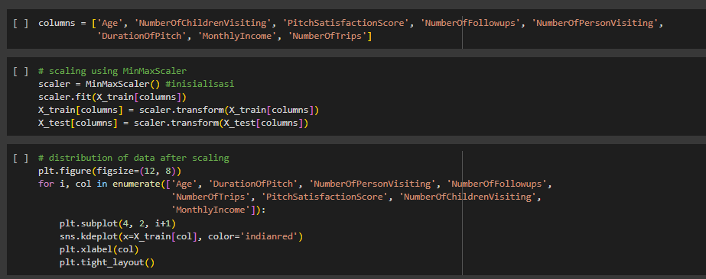
FEATURE
TRANSFORMATION
THE GOAL OF FEATURE TRANSFORMATION IS TO CREATE A DATASET WHERE EACH FORMAT HELPS IMPROVE YOUR AIML MODELS' PERFORMANCE.

Slide 25
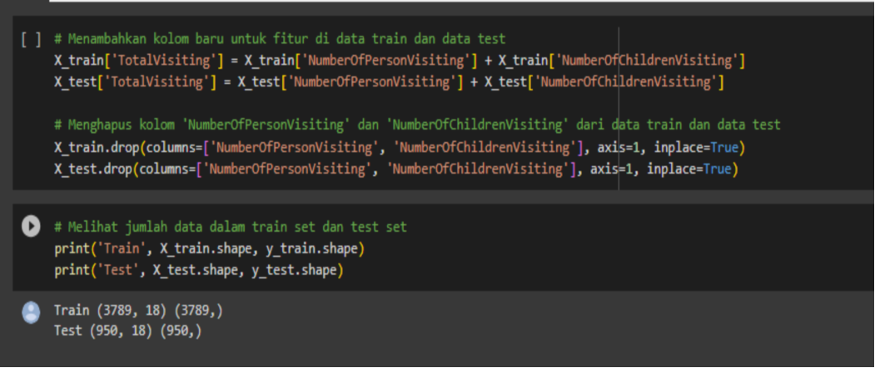

FEATURE EXTRACTION
CREATED NEW COLUMNS FOR FEATURES IN THE TRAIN DATA AND TEST DATA. ADDED THE VALUES OF THE NUMBEROFPERSONVISITING AND NUMBEROFCHILDRENVISITING COLUMNS.

Slide 26

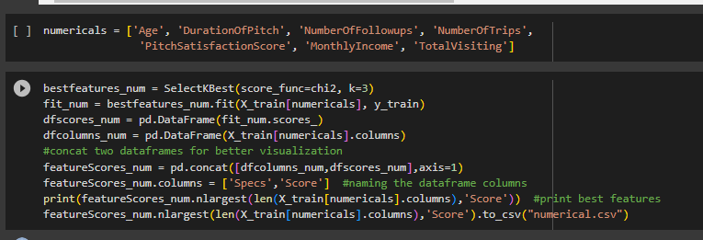
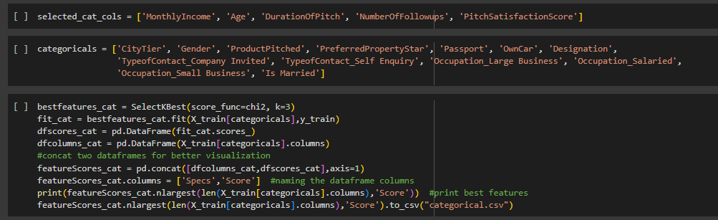
FEATURE SELECTION
REMOVING IRRELEVANT OR REDUNDANT FEATURES BY USING F_CLASSIF METHOD FOR NUMERICAL FEATURES AND CHI2 METHOD FOR CATEGORICAL FEATURES.

Slide 27
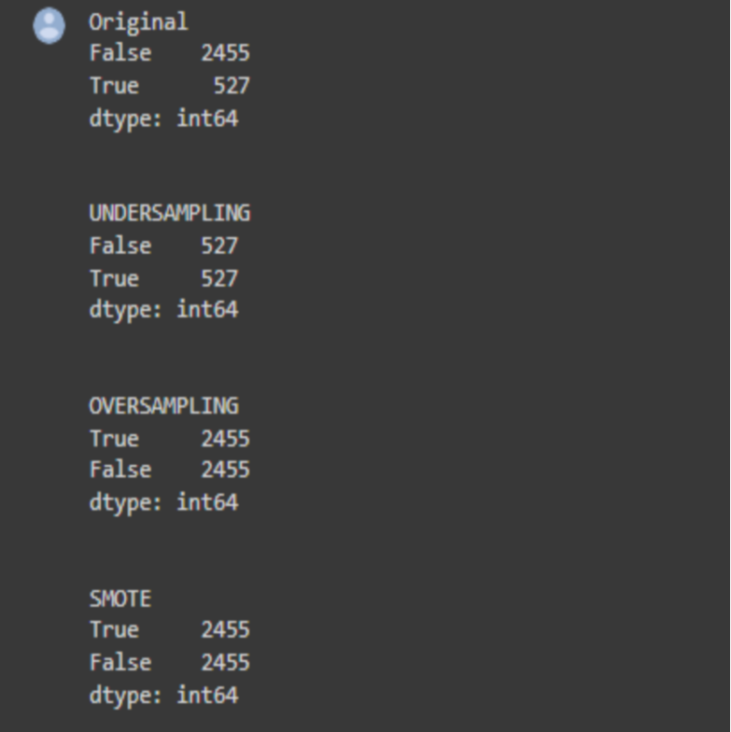

HANDLING
CLASS IMBALANCE
IT SIMPLY INDICATES THAT THE FREQUENCY OF THE TARGET CLASS IS VERY UNBALANCED, I.E. THE OCCURRENCE OF ONE OF THE CLASSES IS VERY HIGH COMPARED TO THE OTHER CLASSES PRESENT. IN THE DATASET WE USE FOR THE TARGET FEATURE "PROD_TAKEN" HAS AN UNBALANCED VALUE.

Slide 28

Classification
Model

Slide 29
Modelling
 | Logistic Regression | Decision Tree | Random Forest | AdaBoost | XGBoost
Accuracy | 0.82 | 0.86 | 0.88 | 0.82 | 0.91
Precision | 0.61 | 0.65 | 0.77 | 0.56 | 0.85
Recall | 0.22 | 0.62 | 0.55 | 0.26 | 0.66
F1-Score | 0.32 | 0.64 | 0.64 | 0.36 | 0.74
AUC | 0.79 | 1.0 | 1.0 | 0.82 | 0.99
Precision metric used for minimizing predicting customers who are not going to buy new product offerings

Slide 30
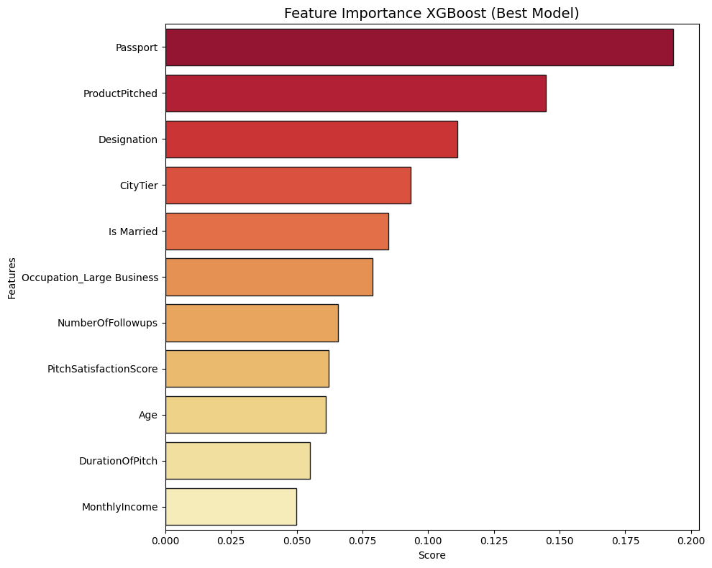
Feature Importance

Slide 31









Business Insight &
Recomendation

Slide 32



Customers who we consider potential to purchase Holiday Packages
Customer who live at
City Tier 2 and 3.
Customers with Executive and
Senior Manager titles
Customer who have Passport
Get at least 5 times follow-up
Age between 18 - 25yo
Notes:
mass market: we approach them through social media, influencer

Slide 33

Conversion Rate
Without and With Model ?(Using Test Data
 | Before Using Model | After Using Model
Total Customer | 950.0 | 140.0
Targeted Customer | 179.0 | 119.0
Conversion Rate | 18.8 | 85.0

Slide 34

Marketing Cost
Without and With Model ?(Using Test Data)
*Assuming the cost is 3 USD per minute, to call a customer
 | Before Using Model | After Using Model
Targeted Customer | 179 | 119
All Cost | 912.58 | 912.58
Spending Cost | 912.58 | 157.1
Saving Cost | 0 | 755.41
% Saving Cost | 0 | 83

Slide 35

Business Recomendation
1. We recommend the Marketing Team to make more offers on
on Basic and Deluxe Products to customers.
2. Prioritise the Single age group with Teenage Age (18-25 years old) with a field duration under 20 minutes.
3. Doing a marketing strategy with a max. call duration of 20 minutes, will
have a greater chance for customers to take the product offered. With a more effective and concise way of offering.
4. Providing coupons or additional discounts to customers who are already
provide additional coupons or discounts to customers who are married, to increase the number of customers who buy holiday packages from the
from that group.
5. The company's marketing team should offer packages based on the customer's monthly income and job title.

Slide 36





Project Conclusion
CVR up to 85 %
Saving cost up to 83%

Slide 37


